Slide 1
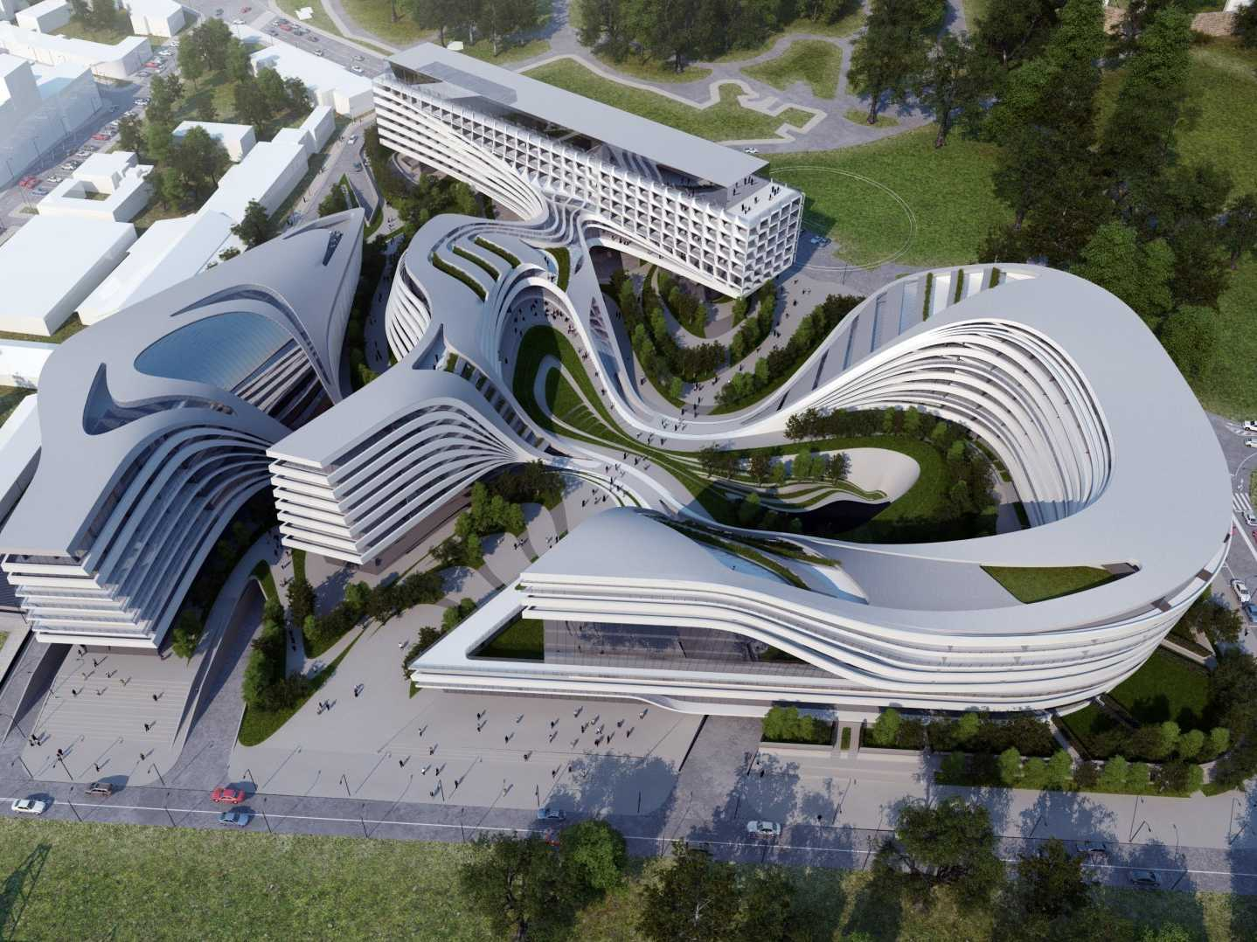
Data Virtualization
Cache Framework
Presenter
Title

Slide 2
Agenda
Overview
Details
Methodologies (Cache Types)

Slide 3
Cache Framework Overview

Slide 4
Overview
What it does
Configure cache
Views and staging views
Load scripts
De-configure cache
Undo all cache configuration and delete generated resources
Refresh cache
Drop/Create indexes [optional], execute table statistics [optional]
Deploy cache resources to target server
Create database tables
Introspect database tables into TIBCO® Data Virtualization

Slide 5
Overview
Terms
Cache Target – One of the supported cache databases
Application – Refers to the business line, business area or subject area in which the cache framework is applied.
There is one cache target per application.
Context – Procedures within an application are executed within the path boundaries defined by the application “Constants”.
Paths, cache data sources and logging are assigned by Constants.
All cache framework operations execute within the paths of the application.
Cache Configuration and De-configuration
Refresh
Deployment

Slide 6
Cache Target Databases
Oracle, SQL Server, Netezza, MemSql, Postgres, Azure SQL Pass, Azure Synapse Analytics (simple cache only)
Supports native cache loading on full cache or incremental initialization
Support Insert/Select for delta loads
Support Merge for Insert, Update, Delete from staging table into cache [Oracle, Sql Server]
Support truncate of staging table
Support pre/post procedures for full cache mode
Supports indexes and Netezza distribution columns
Migrate cached views into Cache Framework

Slide 7
Cache Configuration Methodologies
Full cache – retrieve the full set of rows from the system of record during each cache refresh
Single table – Utilize a single table with a “cachekey”
Multi-table – Utilize multiple tables with no “cachekey”
Supports “TRUNCATE” and “INDEXES” natively
Incremental – retrieve full set of rows for initial load and delta rows thereafter
Pure-Incremental
Uses JDBC to load data for both initial and delta
Hybrid-Incremental
Uses native load for initial and JDBC for delta.
Handles Insert but not Update and Delete from system of record
Merge Incremental
Type 1, 2 and 4 are supported.
Uses native load for initial and JDBC for delta.
Uses native MERGE for Insert, Update, Delete of rows from system of record.

Slide 8
Cache Framework Details
© Copyright 2000-2017 TIBCO Software Inc.
Notes:
Next, let’s examine some common deployment options for DV.

Slide 9
Cache Framework Attributes
CachingData
DV procedure with a list of DV views to manage all cache operations
Insert into CACHING_DATA table
Attribute framework
CACHING_DATA – configuration procedure used to configure behavior on a per view basis using attributes. Attributes use a name/value pair system within the XML format.
KEY_NAME = SDT
KEY_TYPE = TIMESTAMP
KEY_STARTING_VALUE = 1900-01-01 00:00:00
© Copyright 2000-2017 TIBCO Software Inc.

Slide 10
Cache Framework Log
Logging framework
cfLog – log procedure used consistently to log messages
provides the ability to configure output logging level
[ERROR, INFO, AUDIT, DEBUG]
provides the ability to configure where messages are written
DB – write message to AUDIT_LOG table
LOG – write message to DV log file
PRINT – print message to the command line window in Studio
EMAIL – send message via email (not yet implemented)
AuditLogDisplay – ability to display and filter log entries within the application context.
© Copyright 2000-2017 TIBCO Software Inc.

Slide 11
Cache Framework Additional Capabilities
Indexes
Uses DV indexes on the cache view
Recreates indexes on single and multi-table cache objects
For Netezza, generates SQL with distribution columns and does not use indexes
Statistics
Execute table statistics
© Copyright 2000-2017 TIBCO Software Inc.

Slide 12
Cache Framework Methodologies (Cache Types)
© Copyright 2000-2017 TIBCO Software Inc.
Notes:
Next, let’s examine some common deployment options for DV.

Slide 13


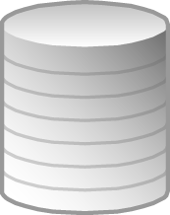


Data Virtualization - Caching
May not need real-time access to all data
Slow data source
Reduce load on operational systems
DV caching
Persists ‘snapshot’ of data
Cached data used for query
Cached data
Cache Methodologies
Full
Single-table
Multi-table
Incremental
Pure
Hybrid (+staging)
Merge (handle ins, upd, del)
Virtual Data Layer
DW / DM
Cache
Optimizer
© Copyright 2000-2017 TIBCO Software Inc.

Slide 14

Data Virtualization – “FS” - Full Single-table Caching Full Refresh
CACHE_TYPE = FS
Native load supported [bcp, dblink, nzload]
Pre- and Post-procedures
Pre- and Post Implementation stub procedures
Cache policies for grouping cache refresh
Individual periodic schedule
Cache Framework supported indexes
Delete From to remove previous cache set
Virtual Data Layer
DW / DM
/Project
/VDB
/Application
/Business
/Physical
sch
policy
V1
V1
pre
preImpl
V1
post
postImpl
T1
SOR
Cache
T1
V1
cachekey
columns
© Copyright 2000-2017 TIBCO Software Inc.

Slide 15
Data Virtualization – “FM” - Full Multi-table Caching Full Refresh
CACHE_TYPE = FM
Native load supported [bcp, dblink, nzload]
Round-robin through multiple tables to support multiple cache sets
Truncate table supported for efficient removal of previous cache set
Pre- and Post-procedures
Cache policies for grouping cache refresh
Individual periodic schedule
Native indexes supported
Virtual Data Layer
DW / DM
/Project
/VDB
/Application
/Business
/Physical
sch
policy
V1
V1
pre
preImpl
V1
post
postImpl
T1
SOR
Cache
Round-robin
T1
V10
V11
columns
V12
© Copyright 2000-2017 TIBCO Software Inc.

Slide 16
Data Virtualization – “IN” - Incremental Caching Incremental Refresh (Pure)
CACHE_TYPE = IN
Accommodate Inserts only
Initial load procedure – JDBC load
Delta load procedure – JDBC load
SDT > incrMaintLevel and SDT <= MaxIncrRow
Individual periodic schedule
Cache Framework supported indexes
Virtual Data Layer
DW / DM
/Project
/VDB
/Application
/Business
/Physical
sch
V1
V1
pIL
V1
pDL
T1
Initial load
Insert/select
Delta load
Insert/select
SOR
Cache
T1
V1
cachekey
columns
© Copyright 2000-2017 TIBCO Software Inc.

Slide 17
Data Virtualization – “MFN” – Merge Filter Native Caching Incremental Refresh (Native)
CACHE_TYPE = IN
Accommodate Inserts and Updates only
Initial load procedure – Native load
Delta load procedure – Native load
SDT > incrMaintLevel and SDT <= MaxIncrRow
Individual periodic schedule
Keytype
bigint (sequence), timestamp, varchar (filter)
Cache Framework supported indexes
Virtual Data Layer
DW / DM
/Project
/VDB
/Application
/Business
/Physical
sch
V1
V1
pIL
V1
pDL
T1
Initial load
Insert/select
Delta load
Insert/select
SOR Cache
T1
cachekey
columns
V1
© Copyright 2000-2017 TIBCO Software Inc.

Slide 18
Data Virtualization – “MFS” – Merge Filter Stage Caching Incremental Refresh (Initial/Delta Stage)
CACHE_TYPE = HN
Accommodate Inserts and Updates only
Initial load procedure –
Insert/Select load into cache table
Delta load procedure –
Insert/Select load into stage table and MERGE into cache table
SDT > incrMaintLevel and SDT <= MaxIncrRow
Individual periodic schedule
Keytype
bigint (sequence), timestamp, varchar (filter)
Cache Framework supported indexes
Virtual Data Layer
DW / DM
/Project
/VDB
/Application
/Business
/Physical
sch
V1
V1
pDl
V1
pIL
T1
Delta load Insert/Select
Initial load
Insert/select
SOR
Cache
T1
V1stg
Local MERGE
V1
cachekey
columns
© Copyright 2000-2017 TIBCO Software Inc.

Slide 19
Data Virtualization – “MT1” - Incremental Merge Type 1 Caching Incremental Refresh (Hybrid)
CACHE_TYPE = MT1
Type 1 – uses audit history delete table
Accommodate Inserts, Updates and Deletes
Merge Into
Initial load procedure – Native load
Delta load procedure – JDBC load
Individual periodic schedule
Cache Framework supported indexes
Virtual Data Layer
DW / DM
/Project
/VDB
/Application
/Business
/Physical
sch
V1
V1
pIL
V1
V1stg
pDL
T1
T1D
Native Initial load
Delta load
Insert/select
cachekey:
IU=99999999
D=99999998
SOR
Cache
T1
V1stg
Local Insert/select
Delta load procedure logic
IU: SDT > incrMaintLevel and SDT <= MaxIncrRow
D: SDT > incrMaintLevel and SDT <= MaxDelrRow
T1D
Native SQL Merge Into
Trigger: Delete
Delete Audit Table:
SDT (delete date)
V1
cachekey
columns
© Copyright 2000-2017 TIBCO Software Inc.

Slide 20
Data Virtualization – “MT2” - Incremental Merge Type 2 Caching Incremental Refresh (Hybrid)
CACHE_TYPE = MT2
Type 2 – uses bi-temporal history table
Accommodate Inserts, Updates and Deletes
Merge Into
Initial load procedure – Native load
Delta load procedure – JDBC load
Individual periodic schedule
Cache Framework supported indexes
Virtual Data Layer
DW / DM
/Project
/VDB
/Application
/Business
/Physical
sch
V1
V1
pIL
V1
V1stg
pDL
T1
T1H
Native Initial load
Delta load
Insert/select
cachekey:
IU=99999999
D=99999998
SOR
Cache
Delta load procedure logic
IU: SDT > incrMaintLevel and SDT <= MaxIncrRow
D: SDT > incrMaintLevel and SDT <= MaxDelrRow and EDT not null and EDT <> ‘9999-12-31’ GROUP BY <key_columns> HAVING <key_columns> not in V1
T1
V1stg
Local Insert/select
T1H
Native SQL Merge Into
Trigger: Insert, Update, Delete
History Table
Bi-temporal: SDT, EDT
V1
cachekey
columns
© Copyright 2000-2017 TIBCO Software Inc.

Slide 21
Data Virtualization – “MT4” - Incremental Merge Type 4 Caching Incremental Refresh (Hybrid)
CACHE_TYPE = MT4
Type 2 – uses CDC-style activity history table
Accommodate Inserts, Updates and Deletes
Merge Into
Initial load procedure – Native load
Delta load procedure – JDBC load
Individual periodic schedule
Cache Framework supported indexes
Virtual Data Layer
DW / DM
/Project
/VDB
/Application
/Business
/Physical
sch
V1
V1
pIL
V1
V1stg
pDL
T1
T1H
Native Initial load
Delta load
Insert/select
cachekey:
IU=99999999
D=99999998
SOR
Cache
Delta load procedure logic
IU: SDT > incrMaintLevel and SDT <= MaxIncrRow
D: SDT > incrMaintLevel and SDT <= MaxDelrRow and ACTIVITY=[I, U, D]
T1
V1stg
Local Insert/select
T1H
Native SQL Merge Into
Trigger: Insert, Update, Delete
History Table
ACTIVITY=[I,U,D],
SDT
V1
cachekey
columns
© Copyright 2000-2017 TIBCO Software Inc.

Slide 22
Data Virtualization – “HN” - Incremental Hybrid Caching Incremental Refresh (Delta No-Stage)
CACHE_TYPE = HN
Accommodate Inserts only
Initial load procedure – Native load
Delta load procedure – JDBC load
SDT > incrMaintLevel and SDT <= MaxIncrRow
Individual periodic schedule
Cache Framework supported indexes
Virtual Data Layer
DW / DM
/Project
/VDB
/Application
/Business
/Physical
sch
V1
V1
pIL
V1
pDL
T1
Native Initial load
Delta load
Insert/select
SOR
Cache
T1
V1stg
Local Insert/select
V1
cachekey
columns
© Copyright 2000-2017 TIBCO Software Inc.

Slide 23
Data Virtualization – “HS” - Incremental Hybrid Caching Incremental Refresh (Delta Stage)
CACHE_TYPE = HS
Accommodate Inserts only
Initial and delta load are the same procedure
Initial and Delta performs a full native load
SDT > incrMaintLevel and SDT <= MaxIncrRow
Individual periodic schedule
Cache Framework supported indexes
Caveat – this cache type should only be used when the source data is a small data set.
Virtual Data Layer
DW / DM
/Project
/VDB
/Application
/Business
/Physical
sch
V1
V1
pIDL
V1
V1stg
T1
Native Initial/delta load
SOR
Cache
T1
V1stg
Local Insert/select
V1
cachekey
columns
© Copyright 2000-2017 TIBCO Software Inc.

Slide 24
Q&A

